Slide 1
Networks of Queues
Software Performance Engineering

Slide 2
Our analysis thus far
We define metrics for each system to measure performance
We use the exponential distribution
  To analyze inter-arrival times in a Markovian stochastic system
  For a single random variable, e.g. “customers arriving”
We use multiple random variables to compute various metrics
  Customer arrival
  Service time
…but…
Systems have more than one queue!
  M/M/m queues where m>1

Slide 3
Central Server Model
IO₁
CPU
IO₂
IO₃

Slide 4
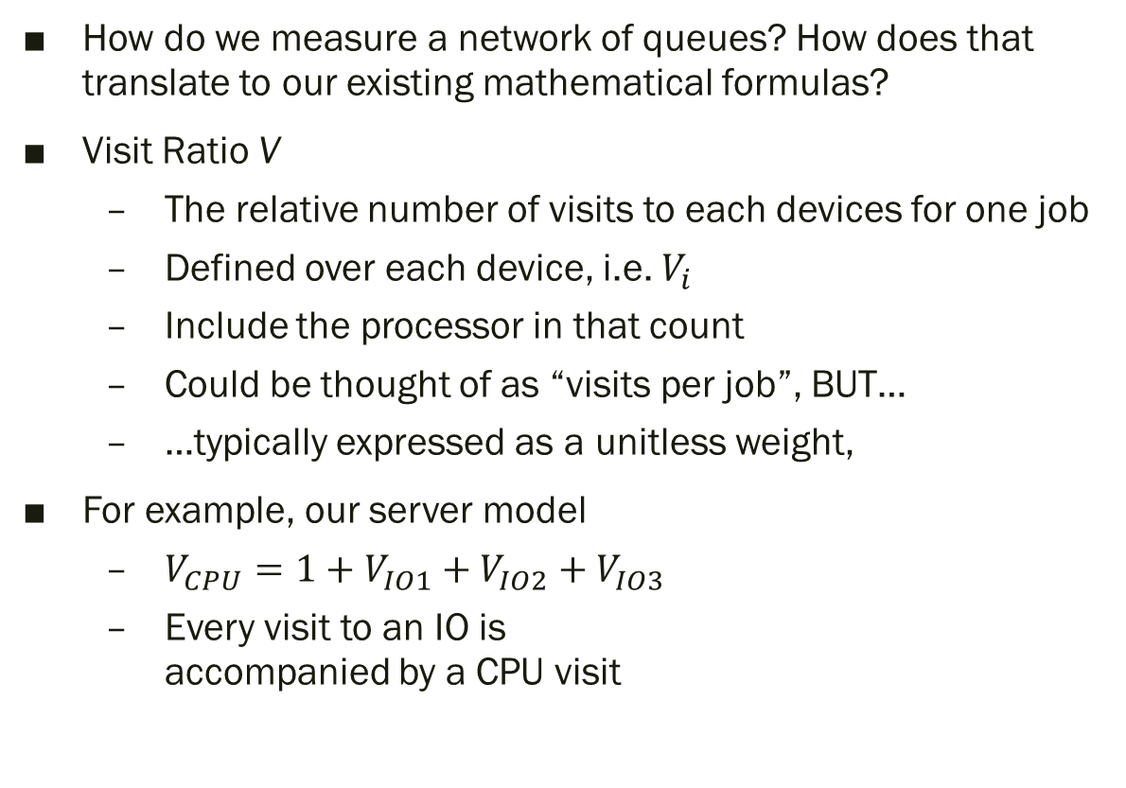
Visit Ratio
How do we measure a network of queues? How does that translate to our existing mathematical formulas?
Visit Ratio V
  The relative number of visits to each devices for one job
  Defined over each device, i.e. $V_{i}$
  Include the processor in that count
  Could be thought of as “visits per job”, BUT…
  …typically expressed as a unitless weight,
For example, our server model
  $V_{CPU}=1+V_{IO1}+V_{IO2}+V_{IO3}$
  Every visit to an IO is
  accompanied by a CPU visit
IO₁
CPU
IO₂
IO₃

Slide 5
Device Ratios Will Differ
Note that IO1, IO2, and IO3 need not be the same numbers!
It all depends on:
  The service time of the current job on the CPU
  The service time of the IO device
  Queuing discipline of each
  Queuing discipline of CPU
Thus, in practice, we try to
measure utilization on
each queue in the
queuing network to get an
accurate visit ratio
IO₁
CPU
IO₂
IO₃

Slide 6
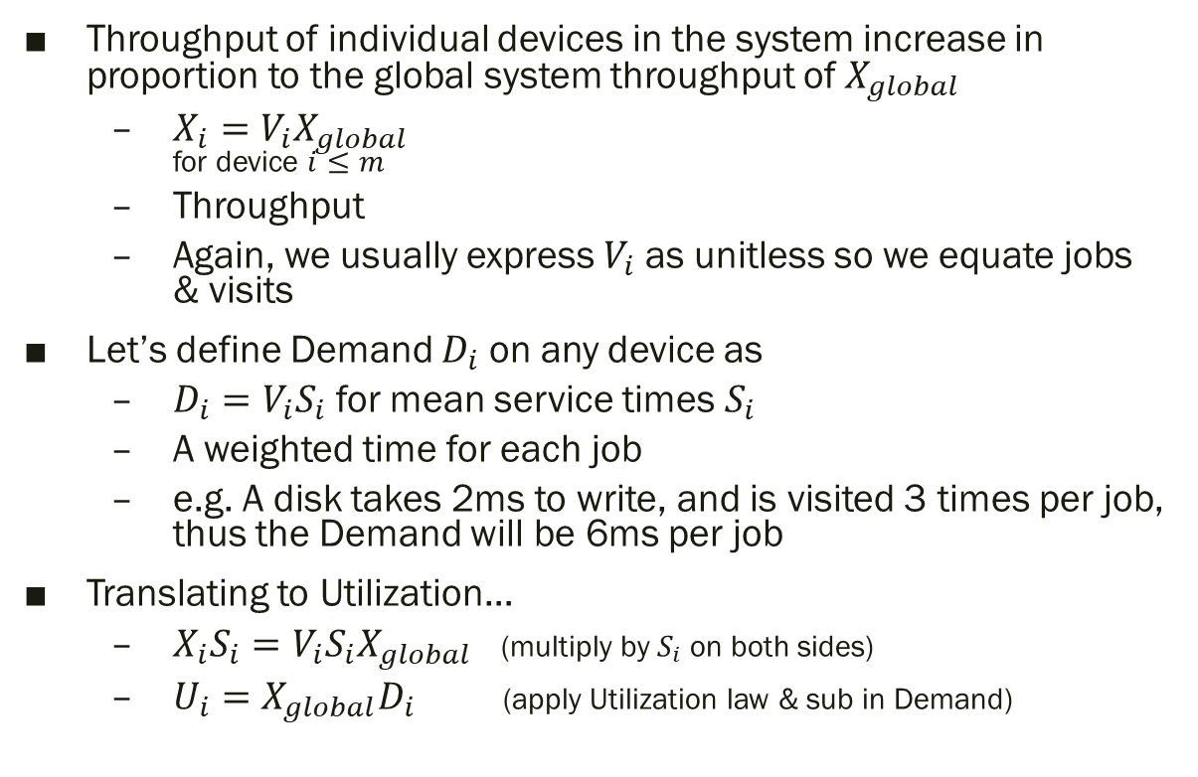
Forced Flow Law
Throughput of individual devices in the system increase in proportion to the global system throughput of $X_{global}$
  $X_{i}=V_{i}X_{global}$
  for device $i≤m$
  Throughput
  Again, we usually express $V_{i}$ as unitless so we equate jobs & visits
Let’s define Demand $D_{i}$ on any device as
  $D_{i}=V_{i}S_{i}$ for mean service times $S_{i}$
  A weighted time for each job
  e.g. A disk takes 2ms to write, and is visited 3 times per job, thus the Demand will be 6ms per job
Translating to Utilization…
  $X_{i}S_{i}=V_{i}S_{i}X_{global}$ (multiply by $S_{i}$ on both sides)
  $U_{i}={X_{global}D}_{i}$ (apply Utilization law & sub in Demand)

Slide 7
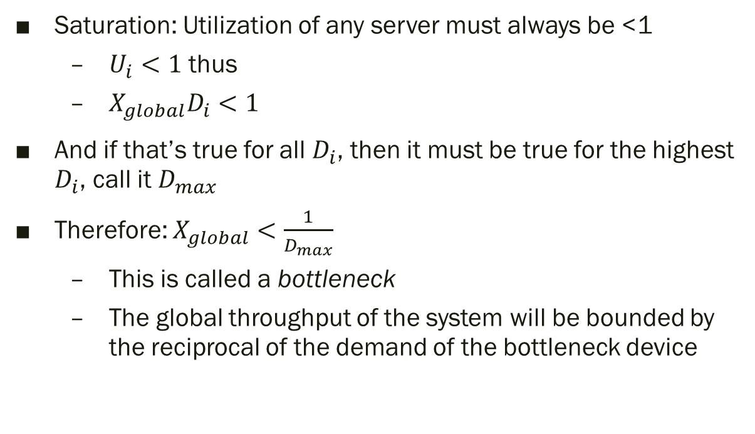

Upper Bounds on $X_{global}$
Saturation: Utilization of any server must always be <1
  $U_{i}<1$ thus
  ${X_{global}D}_{i}<1$
And if that’s true for all $D_{i}$, then it must be true for the highest $D_{i}$, call it $D_{max}$
Therefore: $X_{global}<\frac{1}{D_{max}}$
  This is called a bottleneck
  The global throughput of the system will be bounded by the reciprocal of the demand of the bottleneck device

Slide 8
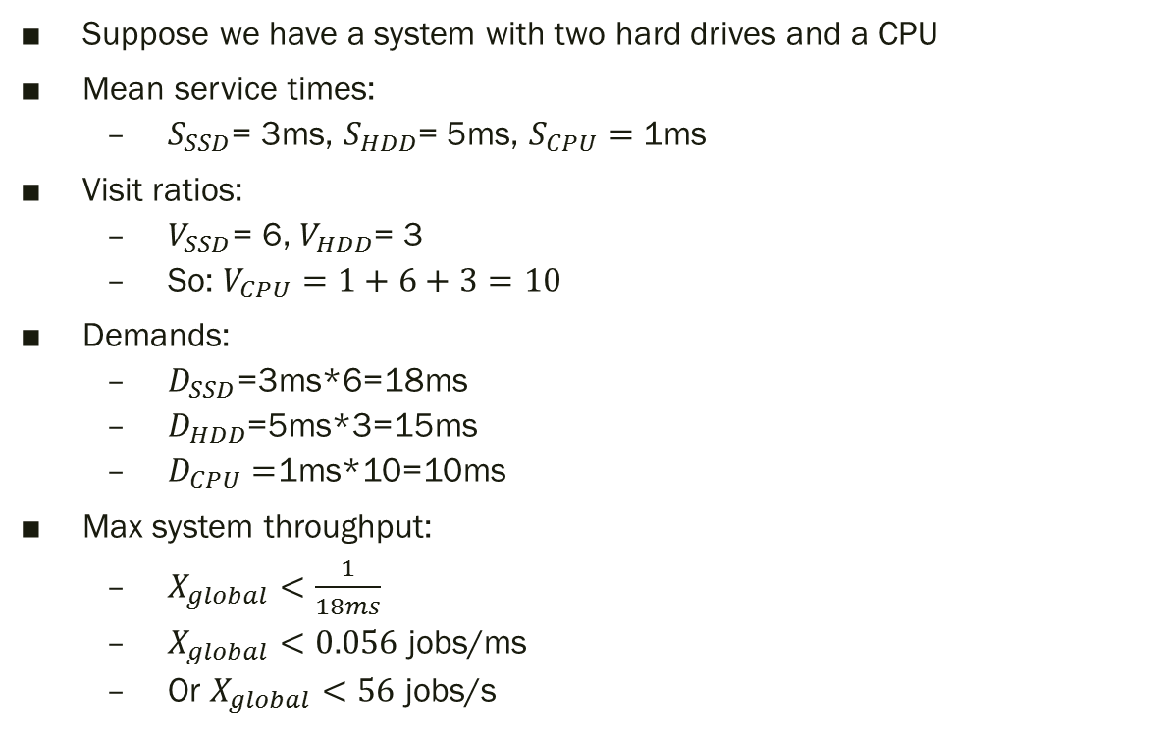
e.g. 2 slow IO devices, fast CPU
Suppose we have a system with two hard drives and a CPU
Mean service times:
  $S_{SSD}$= 3ms, $S_{HDD}$= 5ms, $S_{CPU}=$ 1ms
Visit ratios:
  $V_{SSD}$= 6, $V_{HDD}$= 3
  So: $V_{CPU}=1+6+3=10$
Demands:
  $D_{SSD}$=3ms*6=18ms
  $D_{HDD}$=5ms*3=15ms
  $D_{CPU}=$1ms*10=10ms
Max system throughput:
  $X_{global}<\frac{1}{18ms}$
  $X_{global}<0.056$ jobs/ms
  Or $X_{global}<56$ jobs/s
IO_{SSD}
CPU
IO_{HDD}

Slide 9
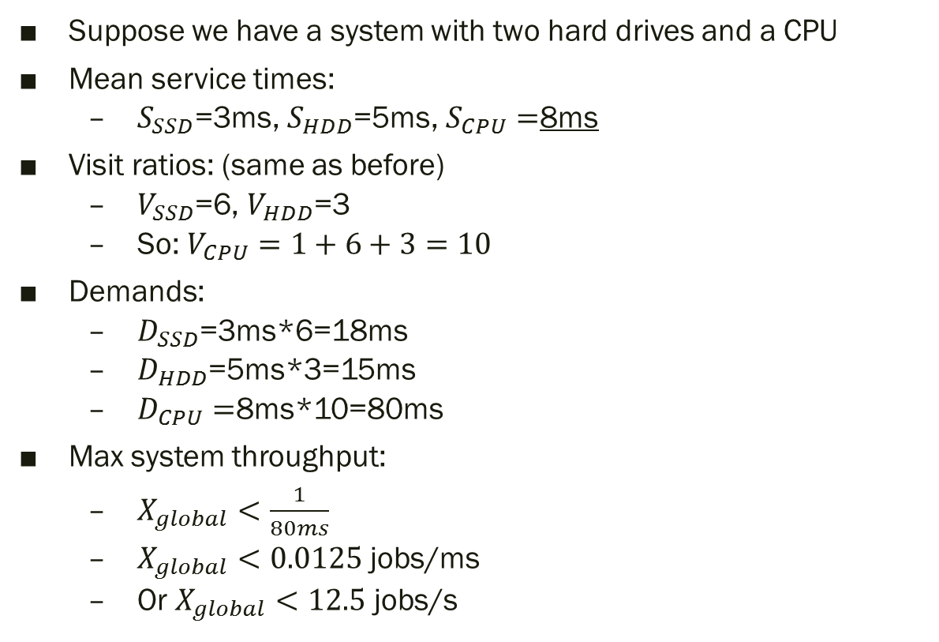
e.g. slow IO devices, slower CPU
Suppose we have a system with two hard drives and a CPU
Mean service times:
  $S_{SSD}$=3ms, $S_{HDD}$=5ms, $S_{CPU}=$8ms
Visit ratios: (same as before)
  $V_{SSD}$=6, $V_{HDD}$=3
  So: $V_{CPU}=1+6+3=10$
Demands:
  $D_{SSD}$=3ms*6=18ms
  $D_{HDD}$=5ms*3=15ms
  $D_{CPU}=$8ms*10=80ms
Max system throughput:
  $X_{global}<\frac{1}{80ms}$
  $X_{global}<0.0125$ jobs/ms
  Or $X_{global}<12.5$ jobs/s
IO_{SSD}
CPU
IO_{HDD}

Slide 10
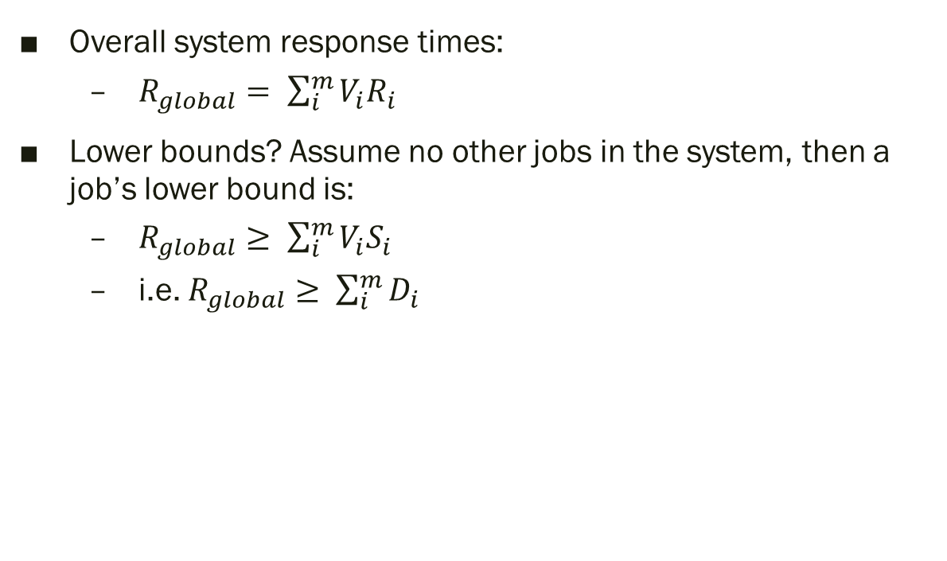
General Response Time Law
Overall system response times:
  $R_{global}= \sum_{i}^{m}{V_{i}R_{i}}$
Lower bounds? Assume no other jobs in the system, then a job’s lower bound is:
  $R_{global}≥ \sum_{i}^{m}{V_{i}S_{i}}$
  i.e. $R_{global}≥ \sum_{i}^{m}{D_{i}}$

